Slide 1
Tutorial 1 Learning Topology Optimization Through Examples and Case Studies
August 18, 2019

Slide 2
Gravity

Slide 3
FEA
v₄
v₃
4
u₄
3
u₃
v
FEA problem
y
v₂
v₁
u
(x,y)
1
u₁
2
u₂
Assembled
stiffness matrix
x
Consistent Nodal Force
Body force
Surface traction

Slide 4
Compliance Sensitivity
v₄
v₃
Compliance
represents
work done by external force
4
u₄
3
u₃
v
y
v₂
v₁
u
(x,y)
1
u₁
2
u₂
x
Element sensitivity for compliance:

Slide 5
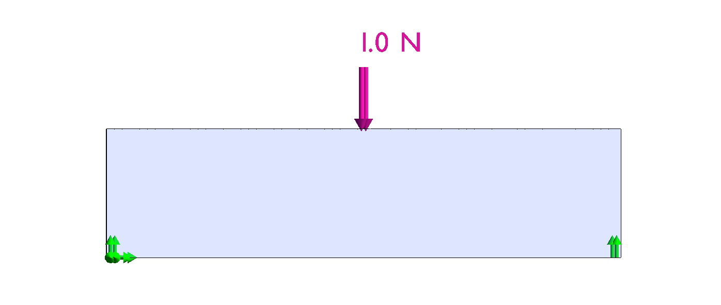
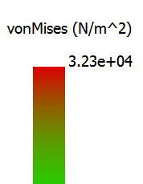
MBB w/o gravity

Slide 6
MBB w/o gravity

Slide 7
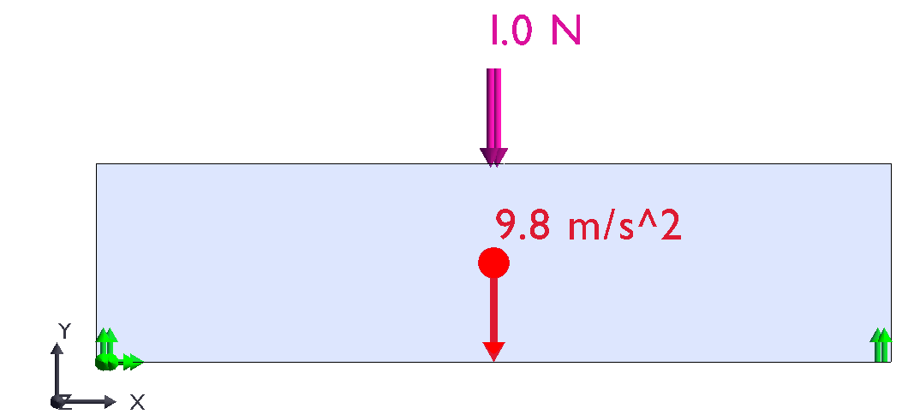
MBB with gravity

Slide 8
MBB with gravity

Slide 9
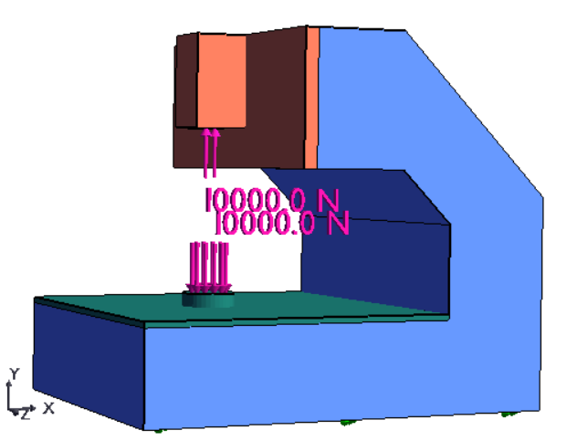
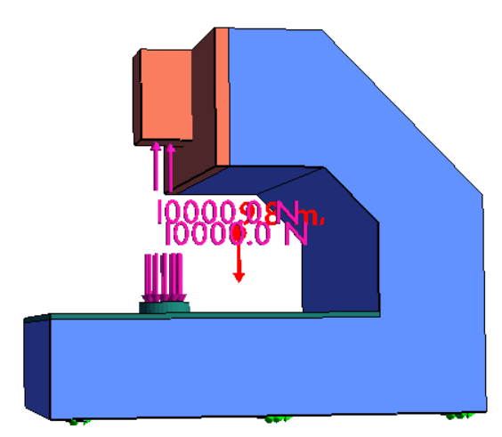
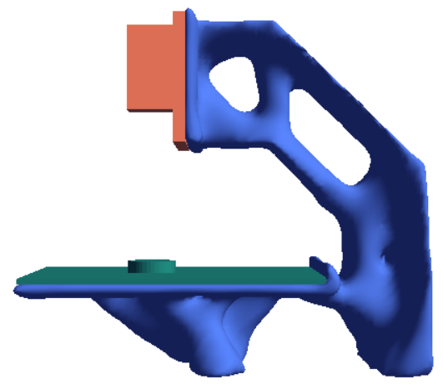
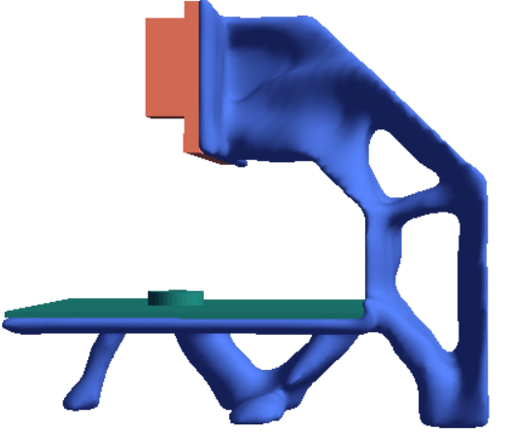
CNC Frame Revisited
No gravity
With gravity

